Slide 1
Project: Image processing(Real Time object Detection)
GANPAT UNIVERSITY
Made By: Raj Paltanwale
Harsh Patel
Kush Patel
Project given by: Mr. Krishna

Slide 2
Introduction
Image Processing is done by taking the image feed and then converting it directly to the threshold image and analyzing the greyscale
Real time image detection is done by taking live camera feed frame by frame and then converting it to the HSV (Hue, Saturation and Value) form.
The HSV form feed is then converted to the Threshold image feed for analyzing the grayscale of the image feed.
The filtered Threshold image feed is then again trace back to the original camera feed and the x and y coordinates are defined for the object which is filtered in the threshold image

Slide 3
Motivation
Advantage of Video-based systems
Being able to capture a large variety of information
Relatively inexpensive
Easier to install, operate, and maintain
Applications
Security surveillance
Home care surveillance
Intelligent transportation systems

Slide 4
About our project
This program is used to detect physical objects in real time and to track their
location in x and y coordinates with respect to the output window.
Vectors are used to change the values of the HSV camera feed.
In this program, Library files of Opencv are used for accessing the camera feed for getting real time input.
such as: <highgui.h>, <cv.h> and others
Morphological operations are used on threshold image to eliminate noise reduction and emphasizing more on the filtered object.

Slide 5
Modules
Some of the main modules created and used in this project are -
createTrackbars : To change the values of HSV vectors.
drawObject : Drawing function to draw crosshairs on the tracked HSV frame.
morphOps : Create structuring element that will be used to "dilate" and "erode" image.
trackFilteredObject : Creat filter object that is used take HSV detected frame to the camera feed.
on_trackbar : To change the position of the trackbar.

Slide 6
Modules
Some other modules created and used in this project are -
Color Filtering
cvtColor() -> converting the BGR image to HSV.
InRange() -> converting the HSV of the threshold Image between a max and min value.

Slide 7
USER Interface
User Interface is created using the qmake binaries with Qt creator IDE
Creating Custom functions for respective functioning of the pushbuttons and dialog box
qmake Header files used -> QFileDialog, QMessageBox etc.
Importing custom header made specifically for this Program ->
mainwindow.h & ui_mainwindow.h

Slide 8
Stage 1: Taking Camera input
Getting Input from the Camera frame by frame through -> capture.camera(0) <- ( 0 for default camera)
Creating video capture object and running an infinite loop -> ex :- while(1)
Passing the Camera feed stream to Stage 2 for further processing

Slide 9
Stage 2 : Converting Image from BGR to HSV
Real time image detection is done by taking live camera feed frame by frame and then converting it to the HSV (Hue, Saturation and Value) form.
(Blue, Green, Red) -> (Hue, Saturation, Value)
Image conversion using cvtColor module.
Passing every image frame input from camera feed to the conversion module for Real Time conversion.

Slide 10
Stage 2 continued : Morphological Operations
Filtering the colors of Interest between a MIN and MAX threshold.
The HSV form feed is then converted to the Threshold image feed for analyzing the grayscale of the image feed.
Filtering object using Erode and Dilate for making the edges smoother for uninterrupted tracking. -> morphOps(threshold)

Slide 11
Stage 2 : Tracking Filtered Object
The filtered Threshold image feed is used to define x and y coordinates.
Passing the x-y coordinates and input threshold image and returning the camera feed output.
-> trackFilteredObject (x, y, camerafeed, threshold)
The filtered Threshold image feed is then again trace back to the original camera feed and the x and y coordinates are defined for the object which is filtered in the threshold image

Slide 12
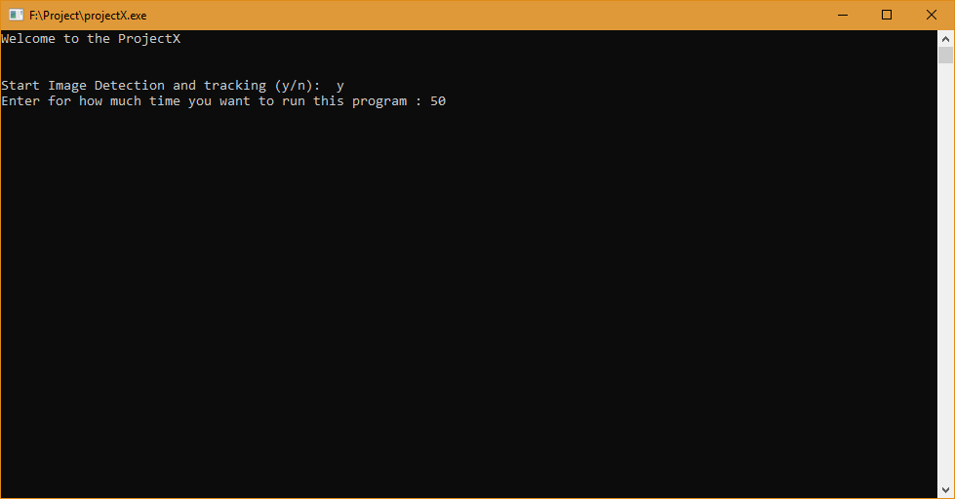
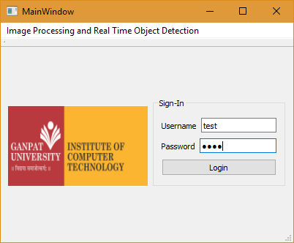
Screenshots
User Interface :

Slide 13
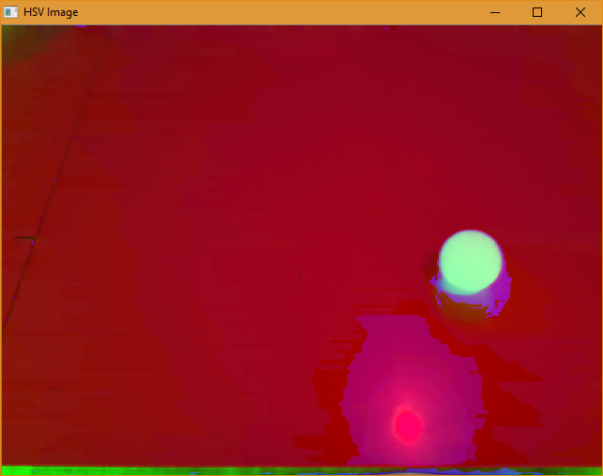
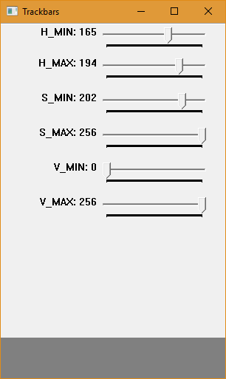
Screenshots
Vectors and HSV Image

Slide 14
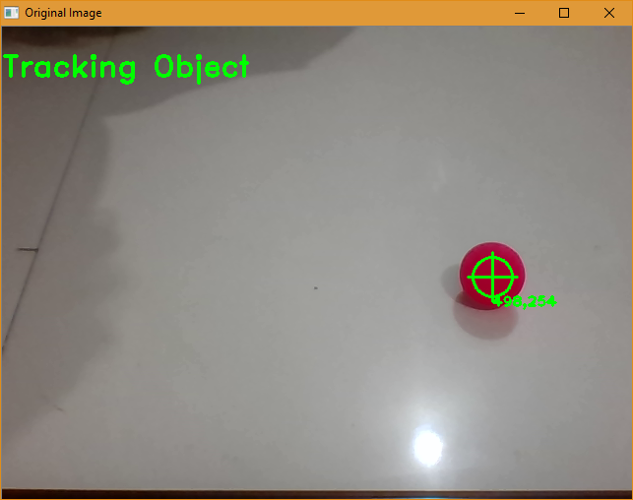
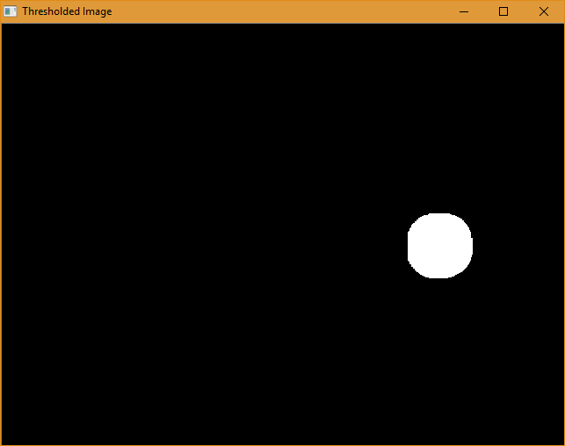
Screenshots
Object tracking :

Slide 15
Work assign to the group members:
Harsh Patel : Taking Real time Input from the camera feed frame by frame and providing it for further processing.
Raj Paltanwale : Providing the project with a subtle and suitable user interface which enables user to use the program efficiently. Taking the camera feed output provided in stage 1 and convert it to HSV and threshold image and detect the filtered object.
Kush Patel : Developing Timing counter for the program.

Slide 16
References taken
Online Materials –
OpenCV tutorials
MIT(OCW) - Open Course Ware
FAB CBA MIT
Qt Creator Examples Prototype
Books –
OpenCV 3 – Computer Vision in C++
NPTEL OpenGL course module 5.17 IISC Bangalore.

Slide 17
Thank you

